Slide 1
Computer Peripherals and Interfacing
Tumpa Rani Shaha
Assistant Professor, Dept of CSE
BSMRSTU

Slide 2
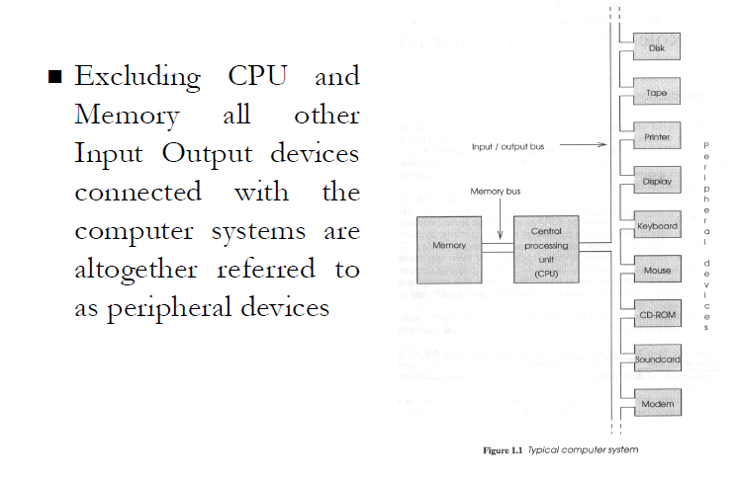
Peripherals
A peripheral is a piece of computer hardware that is added to a computer in order to expand its abilities.

Slide 3
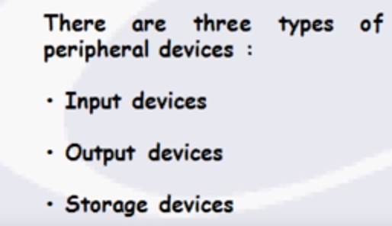
Types of peripheral devices

Slide 4
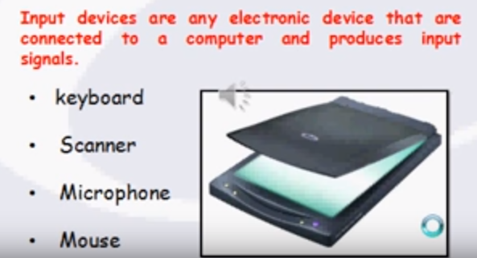
Input Devices

Slide 5
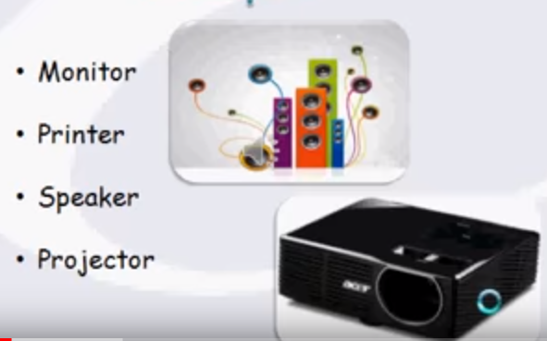
Output Devices

Slide 6
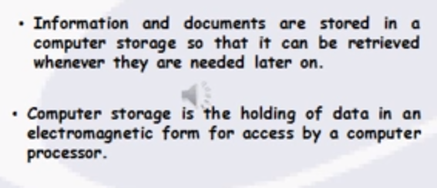
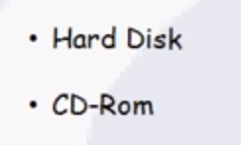
Storage Device

Slide 7
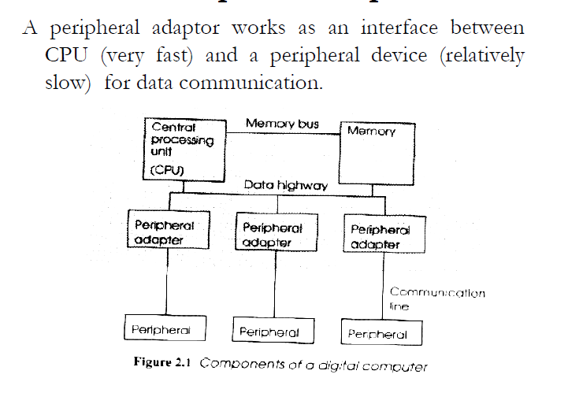
Peripheral Adapter

Slide 8
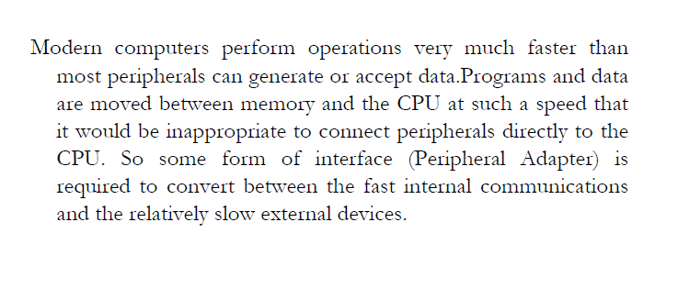
Why peripheral adapters

Slide 9
Input - Output Interface
Input Output Interface provides a method for transferring information between internal storage and external I/O devices.
Peripherals connected to a computer need special communication links for interfacing them with the central processing unit.
The purpose of communication link is to resolve the differences that exist between the central computer and each peripheral.

Slide 10
Input - Output Interface
The Major Differences are:-
Peripherals are electromechanical and electromagnetic devices and CPU and memory are electronic devices. Therefore, a conversion of signal values may be needed.
The data transfer rate of peripherals is usually slower than the transfer rate of CPU and consequently, a synchronization mechanism may be needed
Data codes and formats in the peripherals differ from the word format in the CPU and memory.

Slide 11
Input - Output Interface
4. The operating modes of peripherals are different from each other and must be controlled so as not to disturb the operation of other peripherals connected to the CPU.
To Resolve these differences, computer systems include special hardware components between the CPU and Peripherals to supervises and synchronizes all input and output transfers
■ These components are called Interface Units because they interface between the processor bus and the peripheral devices.

Slide 12
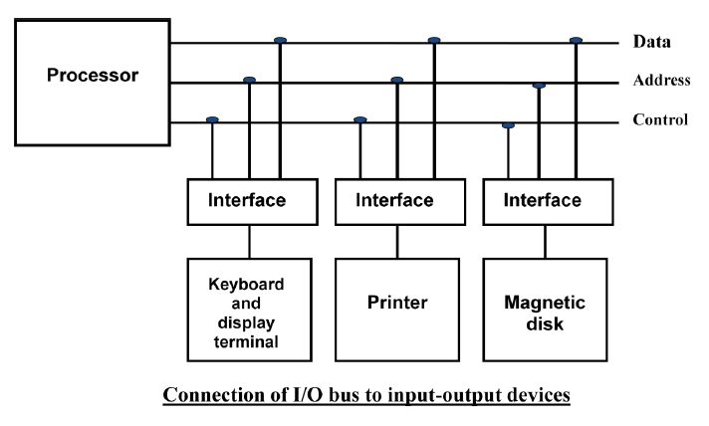
I/O BUS and Interface Module

Slide 13
Purpose of I/O BUS and Interface Module
It defines the typical link between the processor and several peripherals.
The I/O Bus consists of data lines, address lines and control lines.
The I/O bus from the processor is attached to all peripherals interface.
To communicate with a particular device, the processor places a device address on address lines.

Slide 14
Purpose of I/O BUS and Interface Module
Each Interface decodes the address and control received from the I/O bus, interprets them for peripherals and provides signals for the peripheral controller.
It is also synchronizes the data flow and supervises the transfer between peripheral and processor.
Each peripheral has its own controller.
For example, the printer controller controls the paper motion, the print timing

Slide 15
I/O command
The control lines are referred as I/O command. The commands are as following:
Control command- A control command is issued to activate the peripheral and to inform it what to do.
Status command- A status command is used to test various status conditions in the interface and the peripheral.
Data Output command- A data output command causes the interface to respond by transferring data from the bus into one of its registers.
Data Input command- The data input command is the opposite of the data output.

Slide 16
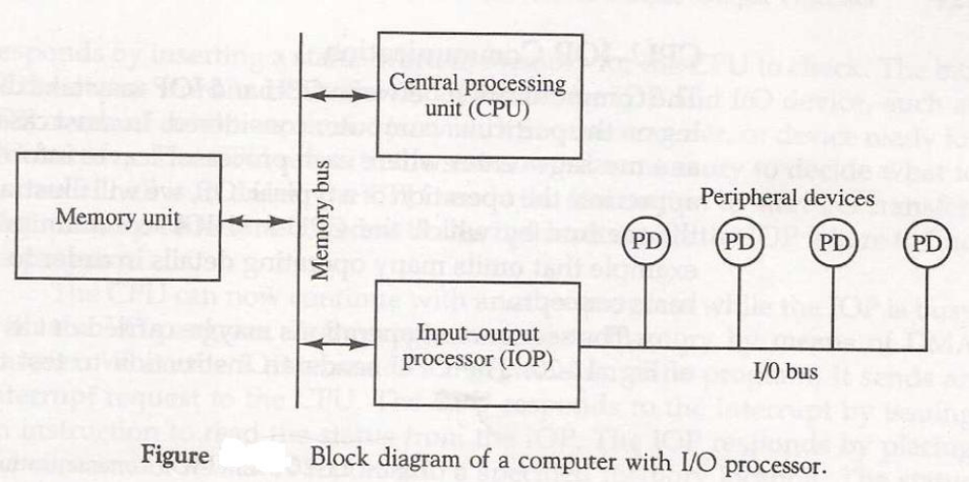
I/O Processor
The purpose of IOP is to provide an independent pathway for the transfer of information between external device and internal memory.

Slide 17
Asynchronous Data Transfer :
This Scheme is used when speed of I/O devices do not match with microprocessor, and timing characteristics of I/O devices is not predictable.
In this method, process initiates the device and check its status. As a result, CPU has to wait till I/O device is ready to transfer data. When device is ready CPU issues instruction for I/O transfer.
In this method two types of techniques are used for data transfer.
Strobe Control
Handshaking

Slide 18
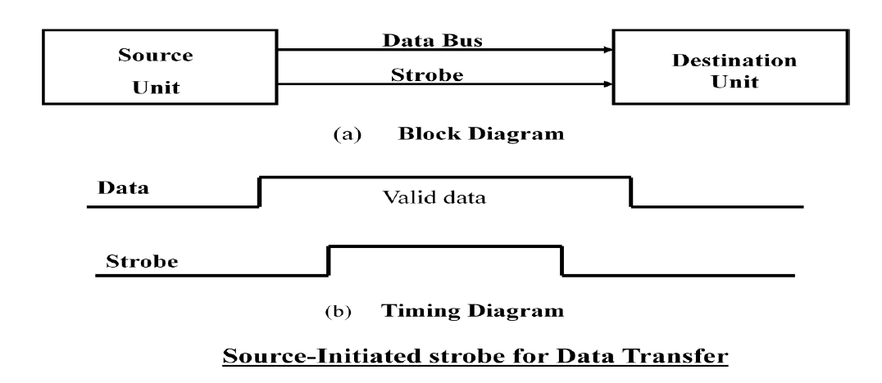
Strobe Signal :
The strobe control method of Asynchronous data transfer employs a single control line to time each transfer. The strobe may be activated by either the source or the destination unit.
Data Transfer Initiated by Source Unit

Slide 19
In the block diagram fig. (a), the data bus carries the binary information from source to destination unit. Typically, the bus has multiple lines to transfer an entire byte or word. The strobe is a single line that informs the destination unit when a valid data word is available.
The timing diagram fig. (b) the source unit first places the data on the data bus. The information on the data bus and strobe signal remain in the active state to allow the destination unit to receive the data.

Slide 20
Data Transfer Initiated by Destination Unit:
In this method, the destination unit activates the strobe pulse, to informing the source to provide the data. The source will respond by placing the requested binary information on the data bus.
The data must be valid and remain in the bus long enough for the destination unit to accept it. When accepted the destination unit then disables the strobe and the source unit removes the data from the bus.

Slide 21
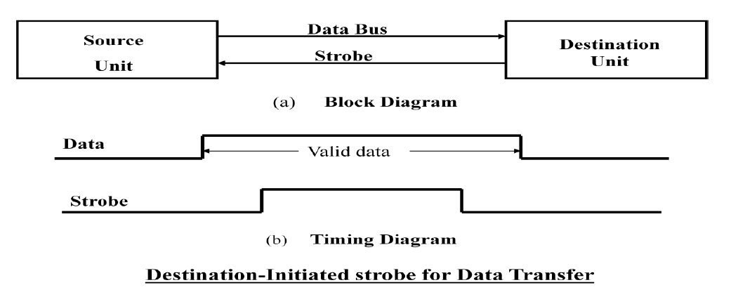

Slide 22
Disadvantage of Strobe Signal :
The disadvantage of the strobe method is that, the source unit initiates the transfer has no way of knowing whether the destination unit has actually received the data item that was places in the bus.
Similarly, a destination unit that initiates the transfer has no way of knowing whether the source unit has actually placed the data on bus. The Handshaking method solves this problem.
The handshaking method solves the problem of strobe method by introducing a second control signal that provides a reply to the unit that initiates the transfer.

Slide 23
Handshaking:
Principle of Handshaking:
One control line is in the same direction as the data flows in the bus from the source to destination. It is used by source unit to inform the destination unit whether there a valid data in the bus.
The other control line is in the other direction from the destination to the source.
It is used by the destination unit to inform the source whether it can accept the data. The sequence of control during the transfer depends on the unit that initiates the transfer.

Slide 24
Source Initiated Transfer using Handshaking:
The sequence of events shows four possible states that the system can be at any given time.
The source unit initiates the transfer by placing the data on the bus and enabling its data valid signal.
The data accepted signal is activated by the destination unit after it accepts the data from the bus.
The source unit then disables its data accepted signal and the system goes into its initial state.

Slide 25
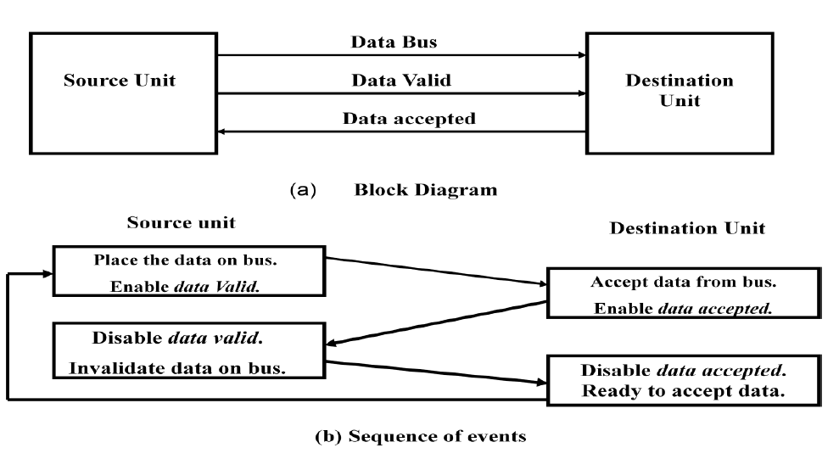
Source Initiated Transfer using Handshaking:

Slide 26
Destination Initiated Transfer Using Handshaking:
The name of the signal generated by the destination unit has been changed to ready for data to reflects its new meaning.
The source unit in this case does not place data on the bus until after it receives the ready for data signal from the destination unit.
From there on, the handshaking procedure follows the same pattern as in the source initiated case.
The only difference between the Source Initiated and the Destination Initiated transfer is in their choice of Initial sate.

Slide 27
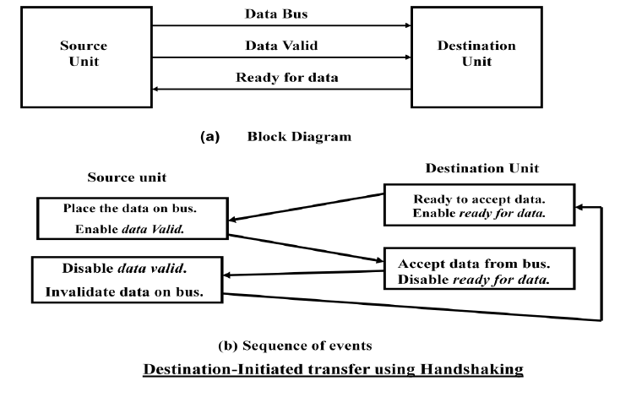
Destination Initiated Transfer Using Handshaking:

Slide 28
Advantage of the Handshaking method:
The Handshaking scheme provides degree of flexibility and reliability because the successful completion of data transfer relies on active participation by both units.
If any of one unit is faulty, the data transfer will not be completed. Such an error can be detected by means of a Timeout mechanism which provides an alarm if the data is not completed within time.

Slide 29
Data Transfer Principle :
Transfer of data is required between CPU and peripherals or memory or sometimes between any two devices or units of your computer system.
To transfer a data from one unit to another one should be sure that both units have proper connection and at the time of data transfer the receiving unit is not busy.

Slide 30
Data Transmission Tree
Data Transmission
Parallel
Serial
Synchronous
Asynchronous

Slide 31
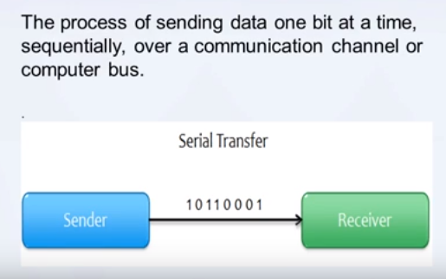
SERIAL COMMUNICATION

Slide 32
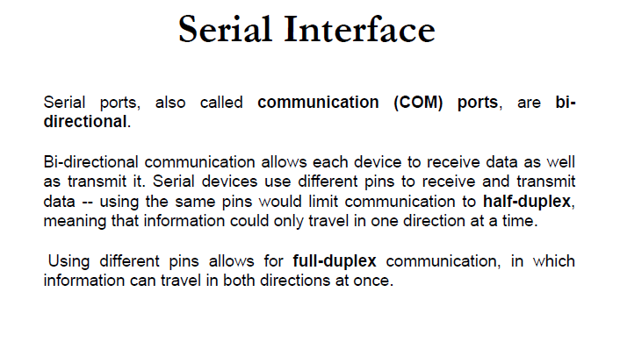

Slide 33
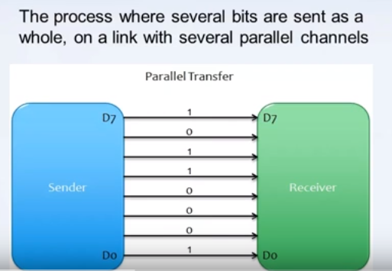
Parallel Communication

Slide 34
Key Differences Between serial transmission and Parallel Transmission
In parallel data transmission, n bit in the message must be transmitted through n separate conductor path.
In serial transmission, each bit in the message is sent in sequence one at a time.
Parallel transmission is faster but it requires many wires.. Serial transmission is slower but is less expensive.

